Slide 1
UniWallet Banking
By Joshua Purushothaman, Jorge Agueros, Aldo Carmona, Rohan Cheruku, Zunaira Firdous, Tejas Ramanujam, Varun Saravanan
Notes:
Josh + Everyone

Slide 2
Objective
1. Improve Financial Confidence & Literacy: Nearly 47% of college students say they don’t feel prepared to manage their money, according to a survey of 30,000 students.
2. Encourage Better Budgeting Habits: Only 39% of students stick to a monthly budget, despite many rating their financial skills as “good” or “excellent.”
3. Reduce Financial Stress & Risky Debt Behaviors: More than half of Gen Z students (53%) report that money management is their most daunting challenge, and only about half (51%) plan to pay off credit card bills in full.
Notes:
Rohan

Slide 3

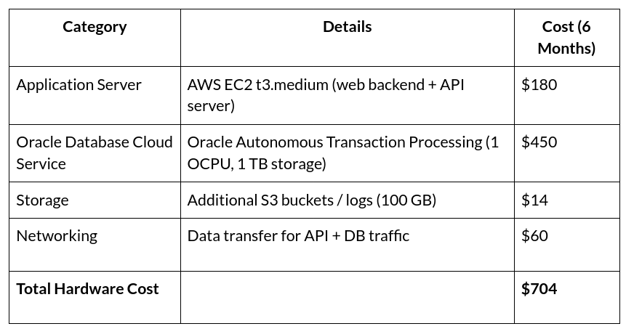
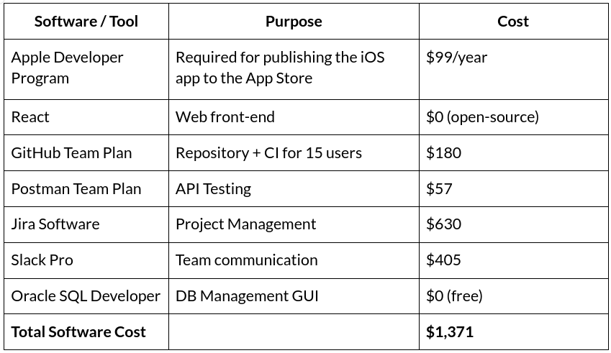
Cost Estimation
Hardware Costs: Software Costs:
Notes:
Tejas

Slide 4
Cost Estimation
Function Point Algorithmic Estimation:
Effort Estimation: 448 FP / 10 Productivity ≈ 44.8 person-months.
Project Duration: 44.8 person-months / 15 developers ≈ 12 weeks.
Personnel Costs:
Developer Cost:
  Pay rate: $35/hour
  Work duration: 60 days × 8 hours/day = 480 hours per developer
  Cost per developer: 480 × $35 = $16,800
  Team of 15 developers: 15 × $16,800 = $252,000
Training Cost
  4 trainees × 50 hours × $20/hour = $4,000
Notes:
Tejas

Slide 5

Project Timeline
Sprint 1
Sprint 2
Sprint 3
Sprint 4
Sprint 5
Sprint 6
Weeks
1-2
3-4
5-6
7-8
9-10
11-12
Requirements & Architecture
Creation of requirements documents and diagrams.
Backend Development
Creation of user account modules, database schema, and Authentication
Backend Development cont.
Creation of user transactions, API creation, and validation logic
Frontend Development
Creation of user interfaces. Main screens and user flows
Polishing
Further refinement of user interfaces. API integration, as well as increase in error Handling
Testing & Deployment
Perform system tests.
Fix bugs.
Deployment
Notes:
Varun

Slide 6
Functional Requirements
1
2
3
4
5
Withdraw
Deposits
Secure Login
Employee Managed
Generate account statements
Add new accounts
The system must allow users to withdraw and deposit funds to and from an account
The System must authenticate user logins such as two-factor authentication
Bank employee must have access to manage customer accounts
The system must generate account statements that provides general information of the user account
The system must allow the addition of new accounts.
Notes:
Jorge

Slide 7
Non-Functional Requirements
1
2
3
4
5
Usability
Performance
Dependability
Security
Ethical
The system shall allow users to check their account balance within 3-4 clicks
The system shall load transaction searches within 3 seconds
The system shall maintain 99% uptime.
The system must encrypt all stored data and shall hash all user passwords
The system must comply with current US banking regulations, and must comply with applicable data protection laws.
Notes:
Jorge

Slide 8

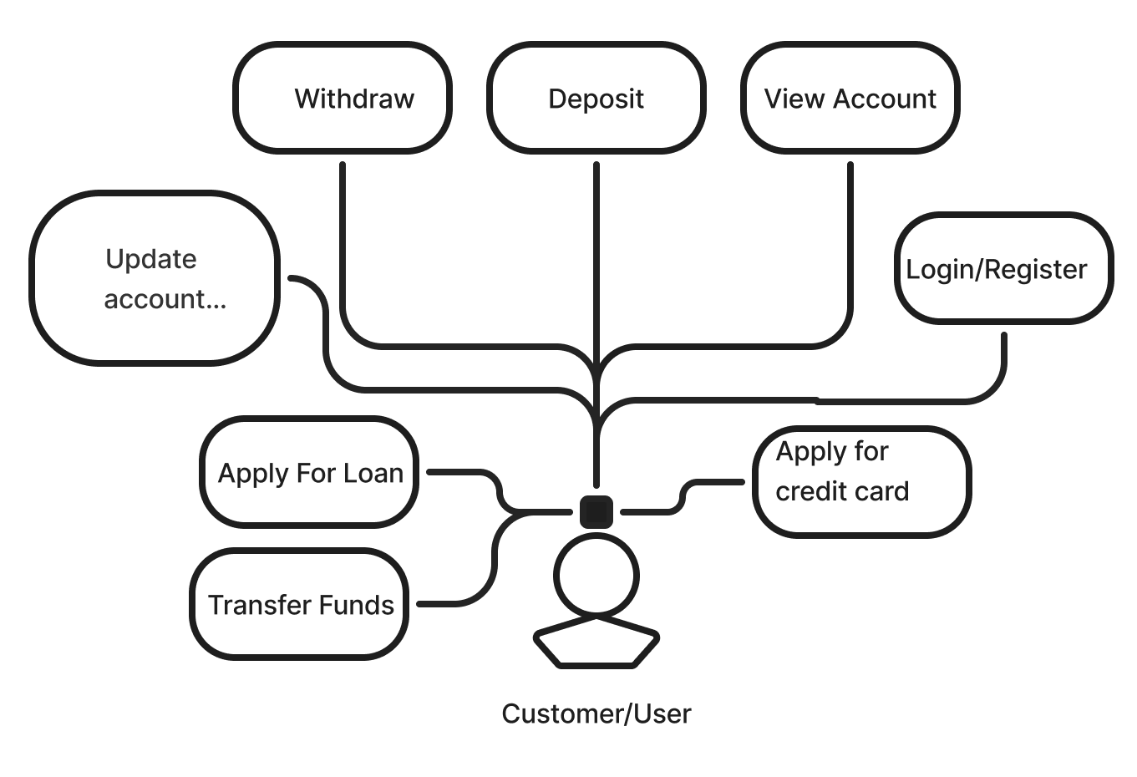
Customer/User
Customer/User
The Customer/User will have their own view of software
Customer can perform the key actions such as withdrawing, depositing, and viewing balances.
Able to manage account settings and preferences.
Include additional functionality such as applying for loans, credit cards and transfer of funds
Notes:
aldo

Slide 9
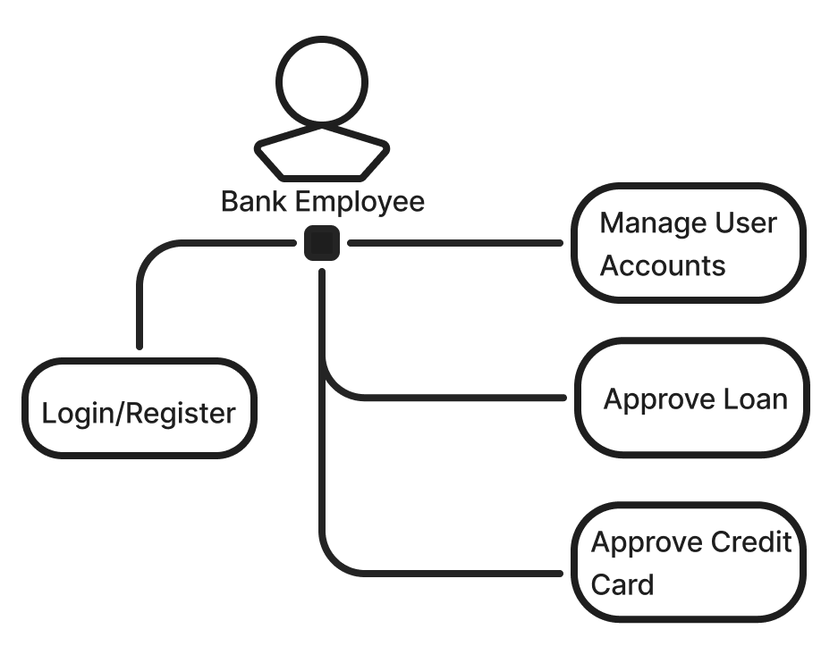
Bank Employee
Bank Employee
Authentication
Bank employees login to access a view separate from the customer
Manages their customers accounts.
Can approve loan and credit card applications
Notes:
aldo

Slide 10
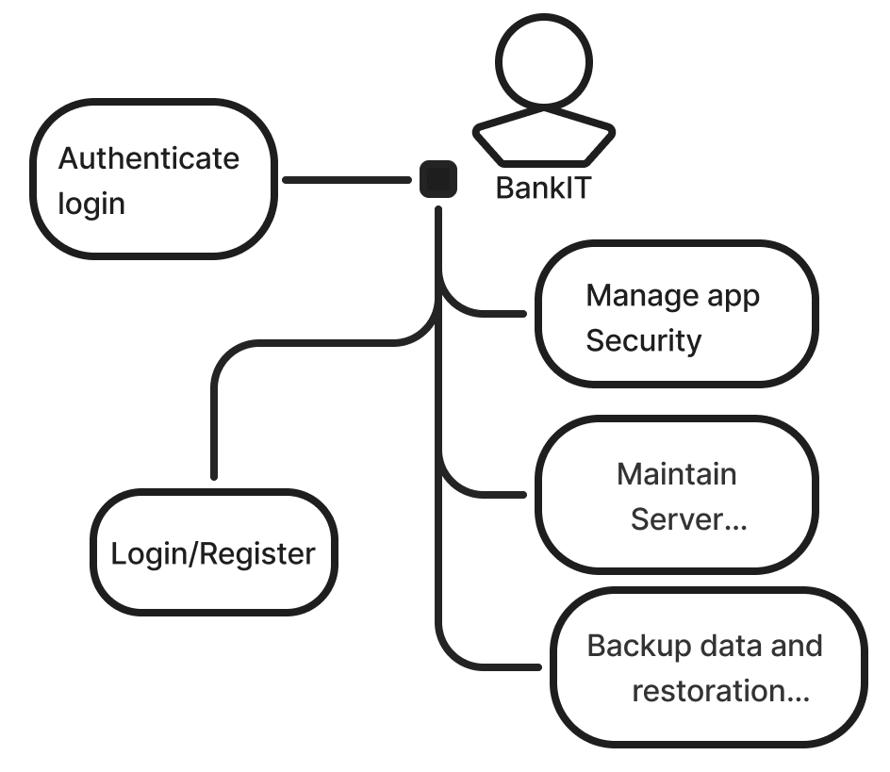
BankIT
Bank IT Employee
The Bank IT team have a separate view where they manage various system functionalities
Login authentication
Software security
Server maintenance
Handles data process such as backups and restoration
Notes:
aldo

Slide 11
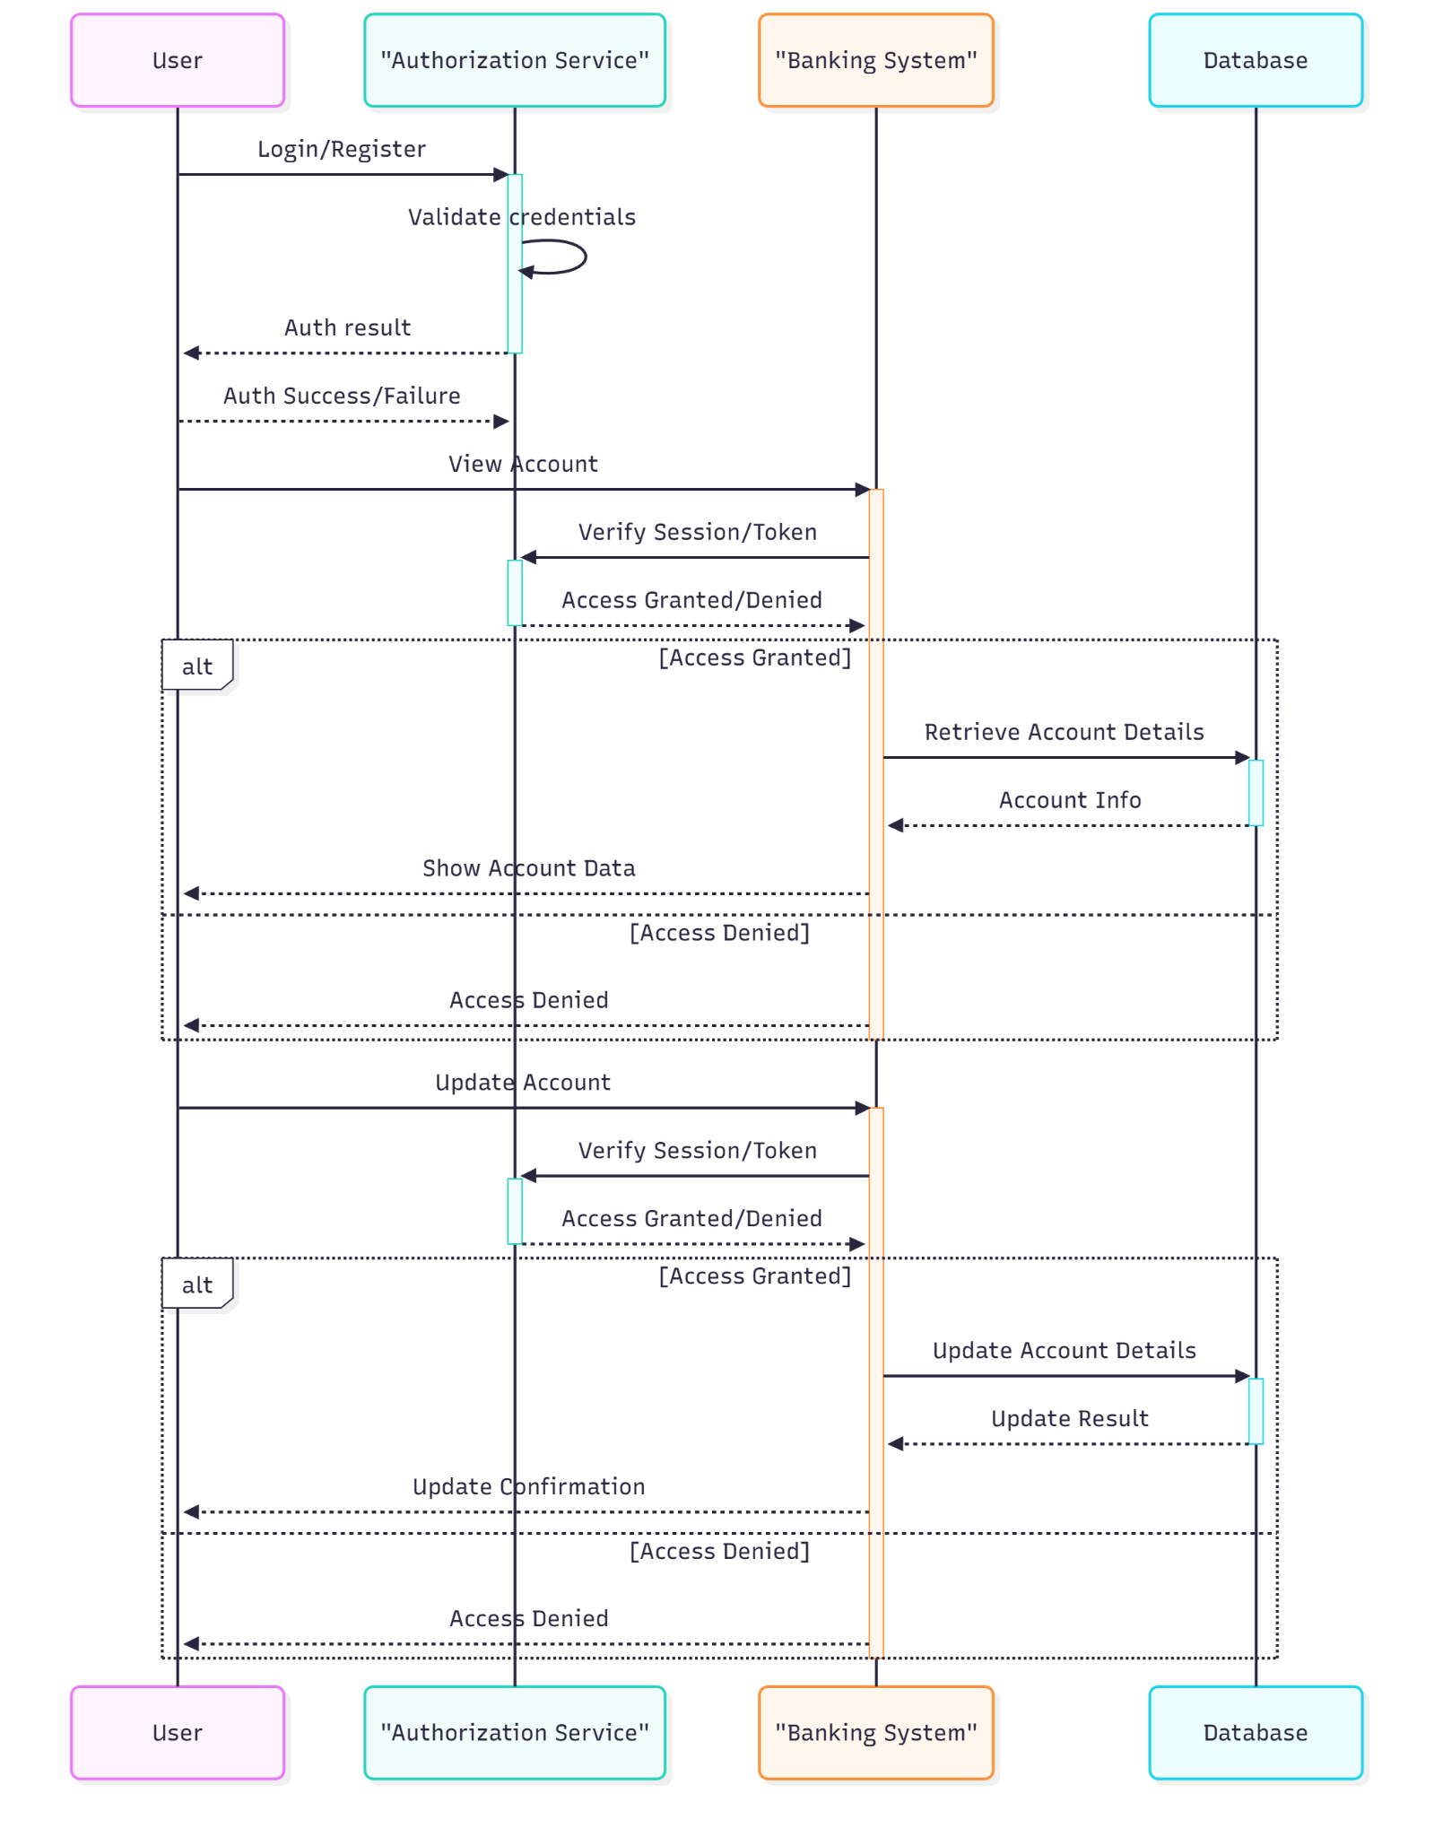
Sequence Diagram
Shows how the user logs in and how every action goes through an authorization check.
Displays the process for viewing the account and how the system retrieves data if access is granted.
Illustrates the update account flow, where the system verifies the session before updating the database.
Highlights that any failed authorization results in access being denied.
Notes:
Rohan

Slide 12
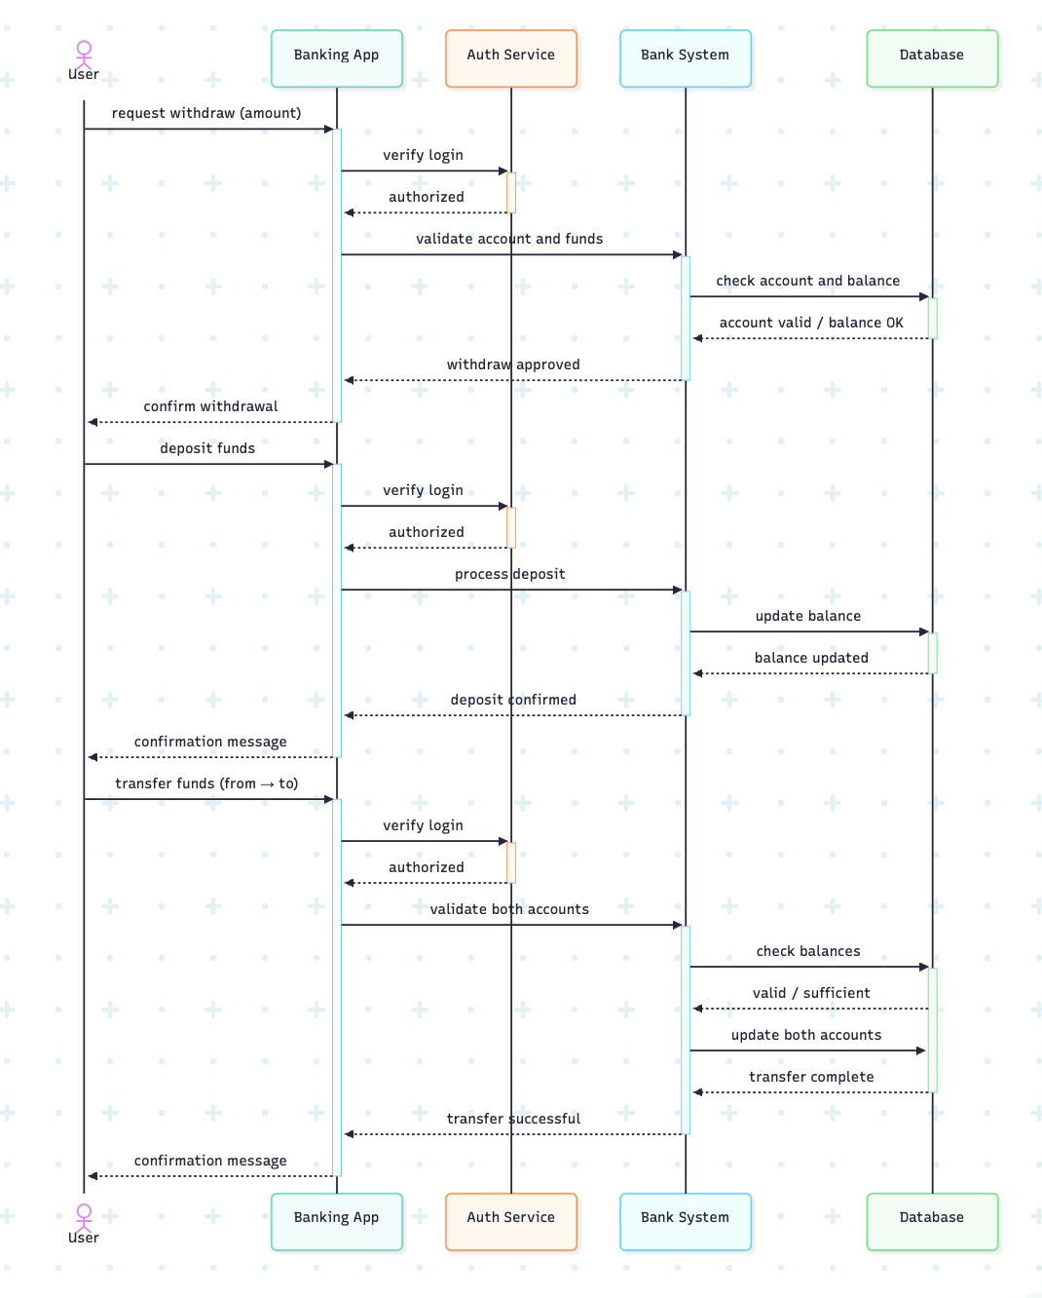
Sequence diagram
This diagram presents how the User, App, Auth Service, Bank System, and Database communicate during withdraw, deposit, login, registration, and fund transfer processes. Activation bars show when each component is actively processing a request.
Notes:
Zunaira

Slide 13
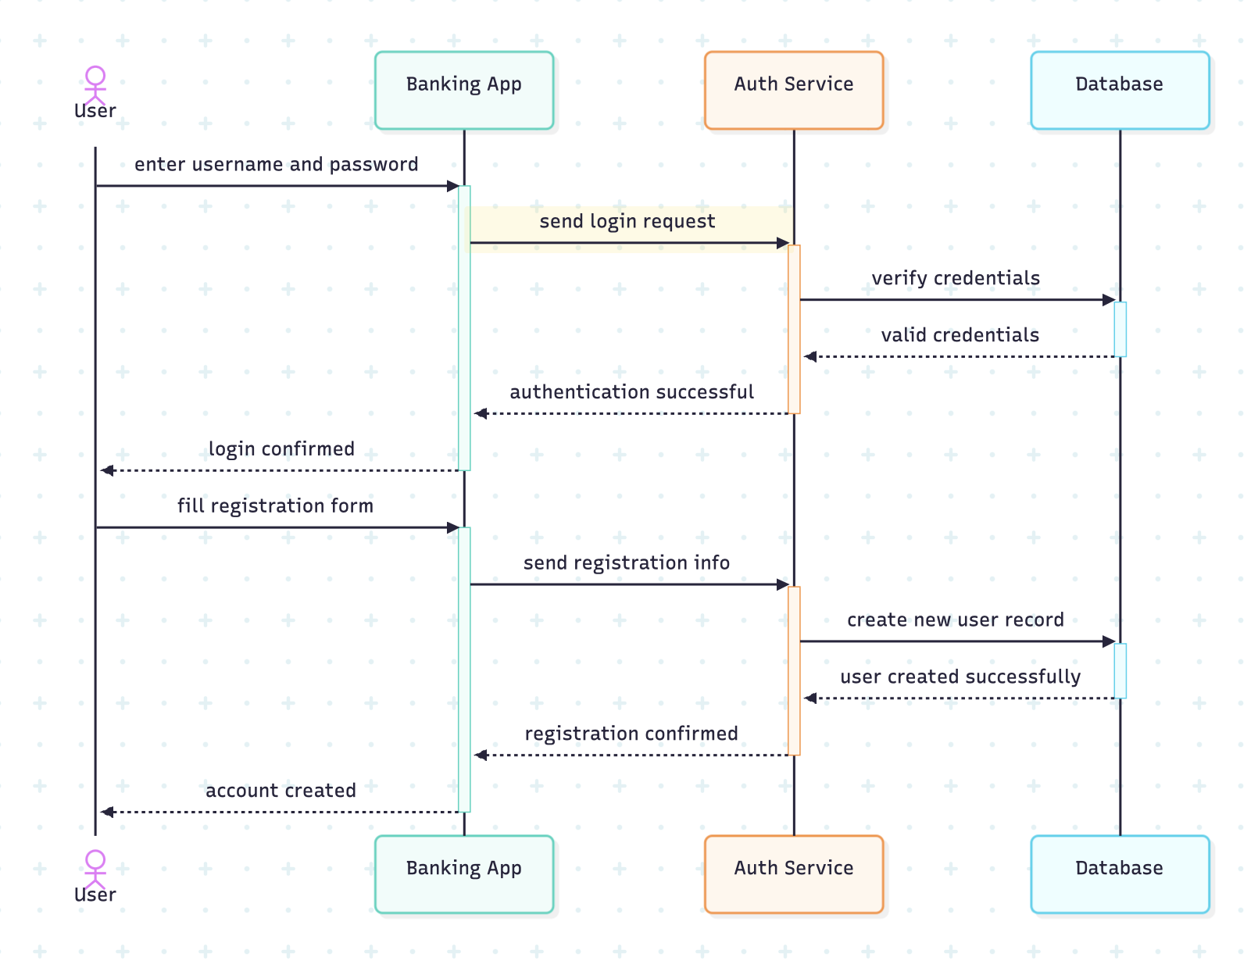
Sequence Diagram
This sequence diagram illustrates how the system handles user login and registration. It shows the message flow between the User, Banking App, Authentication Service, and Database. Activation bars indicate when each component is actively processing the request, highlighting the full interaction sequence from user input to system confirmation.
Notes:
Zunaira

Slide 14
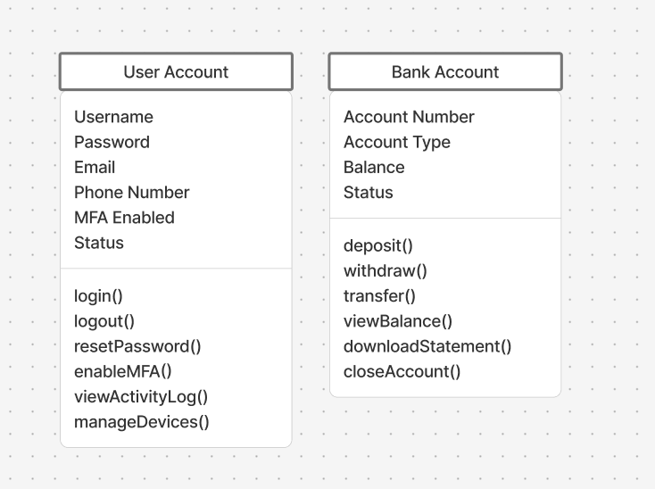
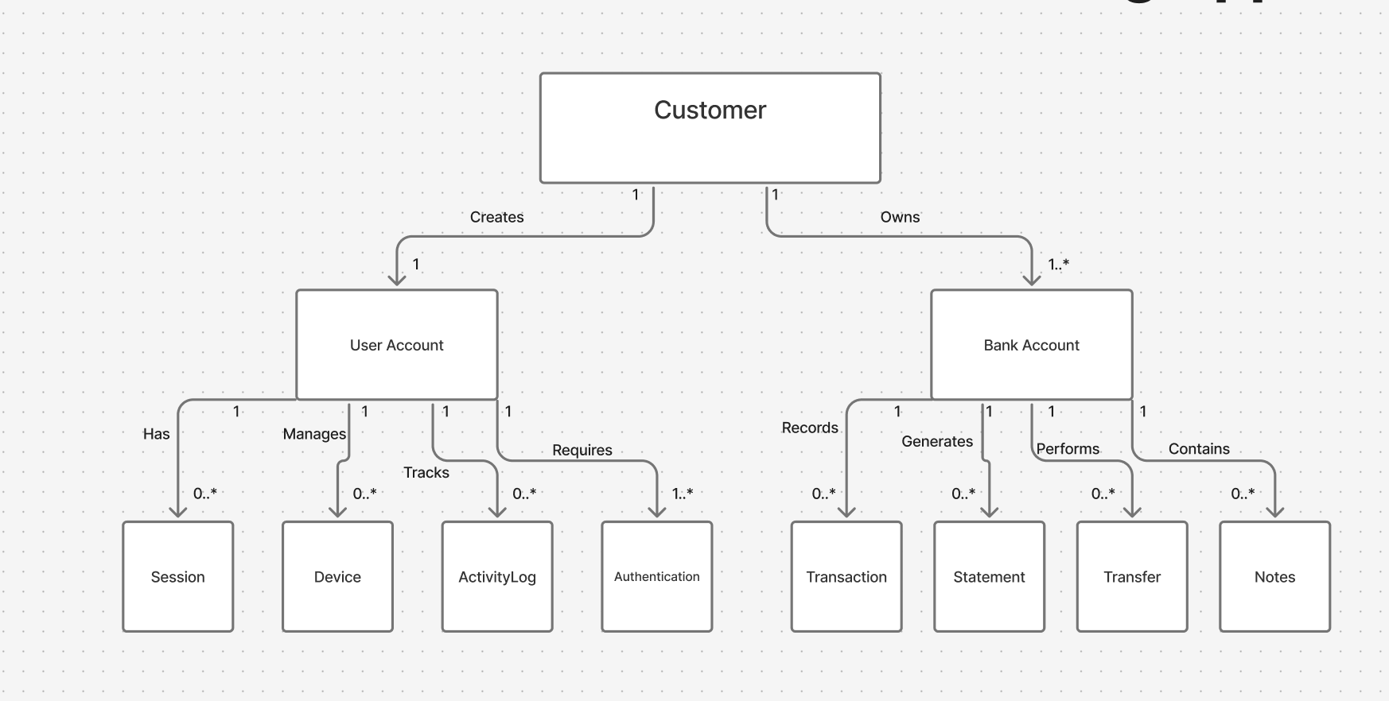
Class diagram
Customer creates one User Account and owns multiple Bank Accounts
User Account handles authentication, sessions, devices, and activity tracking
Bank Account manages transactions, statements, transfers, and notes
System includes security features like MFA and comprehensive activity logging
Notes:
Varun

Slide 15
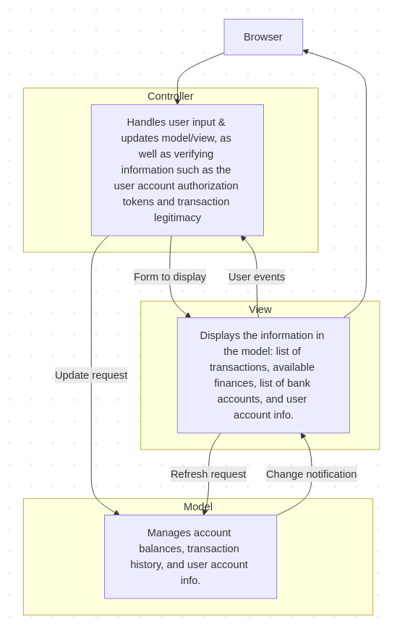
Architectural Design
Our project utilizes the Model-View-Controller(MVC) pattern.
Model: Manages system data and data operations such as:
  account balances, transaction history, and user account information.
View: Displays information from the Model component to the user’s browser.
  List of transactions, current balance.
Controller: Handles user input and passes it into the Model and View components. The component also verifies information and asserts security measures per interaction, such as:
  Withdrawal and user account authorization.
Notes:
Josh

Slide 16
Sources
[1] C. L. Vien, “College students think they manage money well, but they don’t, survey finds,” Journal of Accountancy, Sep. 10, 2015. https://www.journalofaccountancy.com/news/2015/sep/financial-literacy-skills-201512981/
[2] D. Zapp, “Money Matters on Campus Report,” Everfi, Nov. 12, 2025. https://everfi.com/resources/white-paper/money-matters-on-campus-report/
[3] M. Burkhard and J. Madden, “Buckling under Debt and a Lack of Financial Knowledge, College Students Feel Toll of Financial Stress | American International Group, Inc.,” American International Group, Inc., 2019. https://aig.gcs-web.com/news-releases/news-release-details/buckling-under-debt-and-lack-financial-knowledge-college (accessed Nov. 24, 2025).
Notes:
Josh

Slide 17
Thank you!
Questions?
Notes:
Josh

